Slide 1

Stage 5 When Czechs do ASPSU Course Designer: Marcel Englmaier
When Czechs do ASPSU is a 16 round, 80 point Comstock medium course. There are 7 USPSA targets. The best 2 hits per target will score. The start signal is audible.
The Handgun start position is seated in chair, butt touching chair. Handgun is loaded and holstered. The PCC start position is seated in chair, butt touching chair. PCC loaded, stock on belt, safety on.
On the audible start signal, engage all targets from within the shooting area.

Slide 2
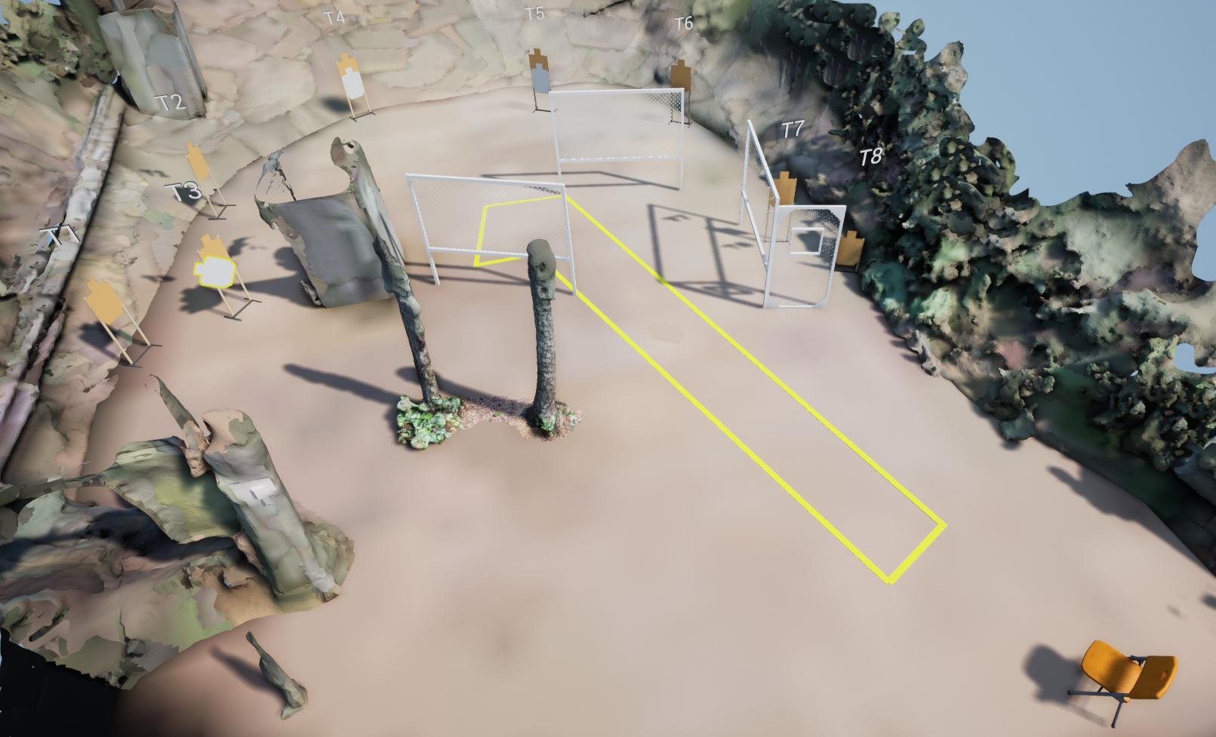
 | Stage 5 When Czechs do ASPSU Course Designer: Marcel Englmaier

